Slide 1
Parallel Processing
By:
Team COA

Slide 2
Syllabus
Parallelism in Uniprocessor system
Evolution of parallel processors
Architectural Classification:
Flynn’s
Fengs
Handler’s Classification
Multiprocessors architecture basics :
Parallel Programming Models :
Shared memory,
Message passing,
Performance considerations :
Amdahl’s law,
performance indications.

Slide 3
Uniprocessor Architecture
A uniprocessor system is defined as a computer system that has a single central processing unit that is used to execute computer tasks.
A typical uniprocessor architecture consist of 3 major components:
Central Processing unit
Memory
Input / Output subsystem
In addition there is common synchronous bus architecture for communication between these components.
Notes:
An synchronous bus works at a fixed clock rate whereas an asynchronous bus data transfer is not dependent on a fixed clock. Asynchronous buses take their timings from the devices involved in the data transfer. Generally in this occurrence of one event is depend on the occurrence of previous events. Advantage of asynchronous is its flexibility. The transmitter and receiver may be function at different clock frequencies.
synchronous bus A bus used to interconnect devices that comprise a computer system where the timing of transactions between devices is under the control of a synchronizing clock signal. Simplicity of implementation is the advantage of synchronous bus

Slide 4
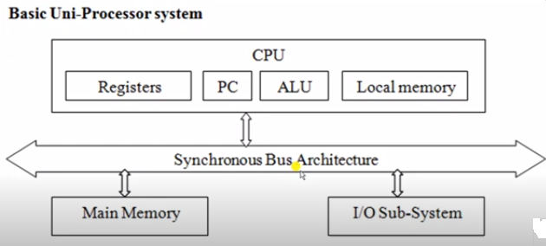

Slide 5
Parallel Processor
Parallel computers are those that emphasize the parallel processing between the operations in some way
Parallel processors are computer systems consisting of multiple processing units connected via some interconnection network plus the software needed to make the processing units work together.
Parallel computers can be characterized based on the data and instruction streams forming various types of computer organisations.

Slide 6
Why Parallel Processor?
The main argument for using multiprocessors is to create powerful computers by simply connecting multiple processors.
Advantages of Parallel Processor:
Faster speed
Cost-effective
Fault tolerance

Slide 7
Evolution of Parallel processors
Evolution of computing is divided into four major era based on batch, time-sharing, desktop, and network.
Batch Era
Time sharing Era
Desktop Era
Network Era

Slide 8
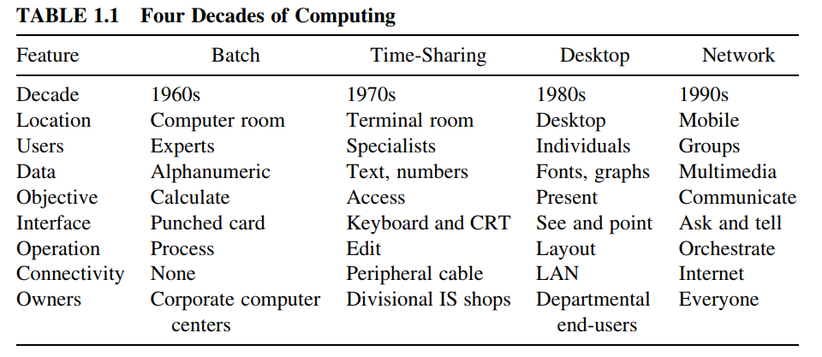

Slide 9
Architectural Classification
The following classification of parallel computers have been identified: 1) Classification based on the instruction and data streams 2) Classification based on the structure of computers 3) Classification based on how the memory is accessed 4) Classification based on grain size

Slide 10
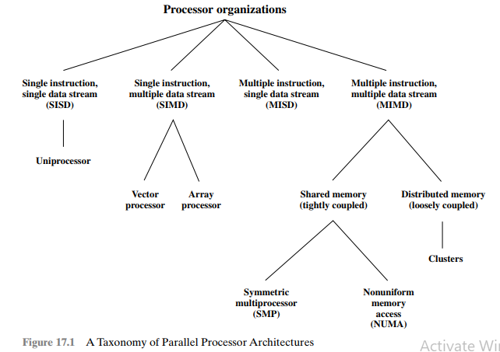

Slide 11
Flynn’s Classification
The most popular taxonomy of computer architecture was defined by Flynn in 1966.
Flynn’s classification scheme is based on the notion of a stream of information.
Single instruction, single data stream – SISD
Single instruction, multiple data stream – SIMD
Multiple instruction, single data stream – MISD
Multiple instruction, multiple data stream- MIMD

Slide 12
Instruction & Data stream
The instruction stream is defined as the sequence of instructions performed by the processing unit.
The data stream is defined as the data traffic exchanged between the memory and the processing unit.

Slide 13
SISD

Slide 14
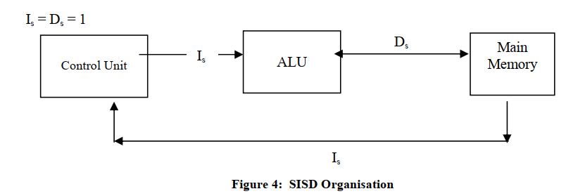
SISD

Slide 15
SIMD

Slide 16
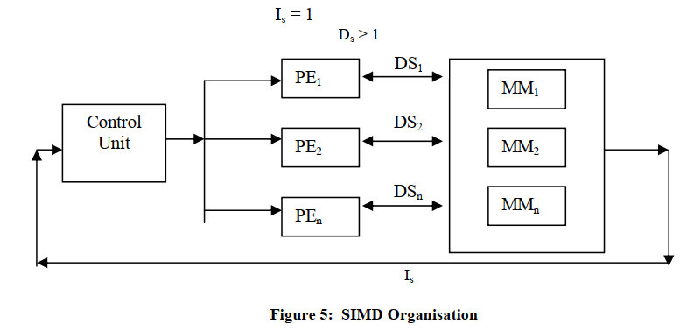
SIMD

Slide 17
MISD

Slide 18
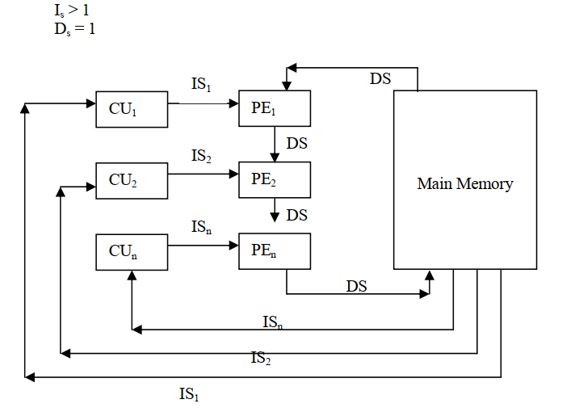
MISD

Slide 19
MIMD

Slide 20
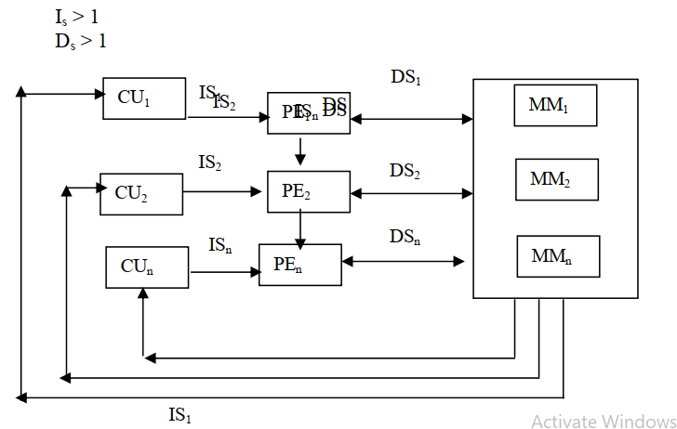
MIMD

Slide 21
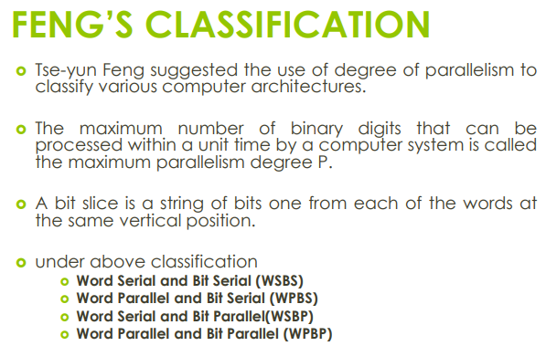
FENG’S CLASSIFICATION

Slide 22
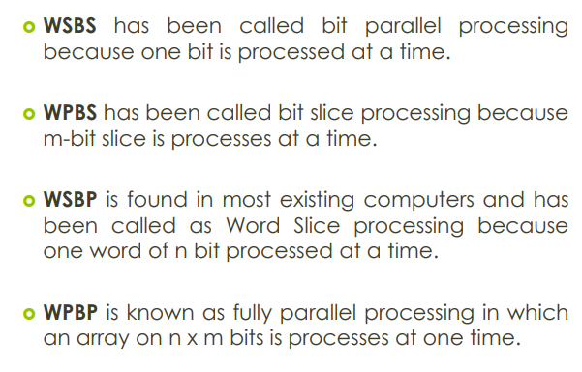
FENG’S CLASSIFICATION

Slide 23
Handler’s Classification
In 1977, Wolfgang Handler proposed an elaborate notation for expressing the pipelining and parallelism of computers.
Handler's classification addresses the computer at three distinct levels: • Processor control unit (PCU) • Arithmetic logic unit (ALU) • Bit-level circuit (BLC)
BLC: logic circuit needed to perform one bit operations in the ALU.

Slide 24
Handler's classification uses the following three pairs of integers to describe a computer: Computer = (p * p', a * a', b * b') Where
p = number of PCUs p'= number of PCUs that can be pipelined a = number of ALUs controlled by each PCU a'= number of ALUs that can be pipelined b = number of bits in ALU or processing element (PE) word b'= number of pipeline segments on all ALUs or in a single PE

Slide 25
The following rules and operators are used to show the relationship between various elements of the computer: • The '*' operator is used to indicate that the units are pipelined or macro-pipelined with a stream of data running through all the units. • The '+' operator is used to indicate that the units are not pipelined but work on independent streams of data. • The 'v' operator is used to indicate that the computer hardware can work in one of several modes. • The '~' symbol is used to indicate a range of values for any one of the parameters. • Peripheral processors are shown before the main processor using another three pairs of integers. If the value of the second element of any pair is 1, it may omitted for brevity. Handler's classification is best explained by showing how the rules and operators are used to classify several machines.

Slide 26
Example
The CDC 6600 has a single main processor supported by 10 I/O processors. One control unit coordinates one ALU with a 60-bit word length. The ALU has 10 functional units which can be formed into a pipeline. The 10 peripheral I/O processors may work in parallel with each other and with the CPU. Each I/O processor contains one 12-bit ALU. The description following:
10 I/O processors is: CDC 6600I/O = (10, 1, 12)
Main processor is: CDC 6600main = (1, 1 * 10, 60)
Macro-pipeline of CDC 6600 :
=(I/O processors) * (central processor)
= (10, 1, 12) * (1, 1 * 10, 60)

Slide 27
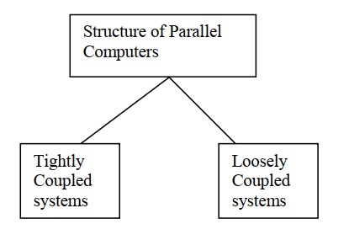
Multiprocessors architecture Structure

Slide 28
Cont..
When multiprocessors communicate through the global shared memory modules then this organisation is called Shared memory computer or Tightly coupled systems.
when every processor in a multiprocessor system, has its own local memory and the processors communicate via messages transmitted between their local memories, then this organisation is called Distributed memory computer or Loosely coupled system.

Slide 29
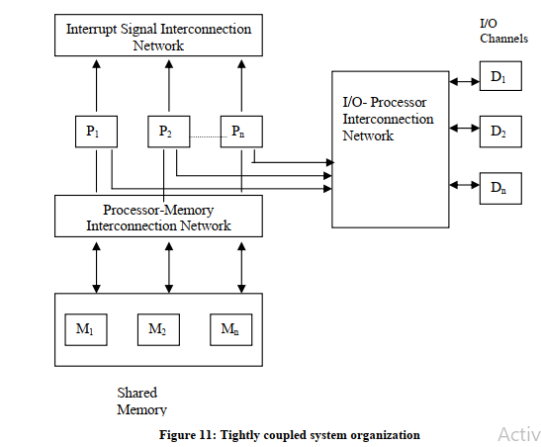
Tightly coupled systems

Slide 30
Tightly coupled systems
multiple processors share a global main memory, which may have many modules as shown in detailed Figure 11. The processors have also access to I/O devices. The inter- communication between processors, memory, and other devices are implemented through various interconnection networks,

Slide 31
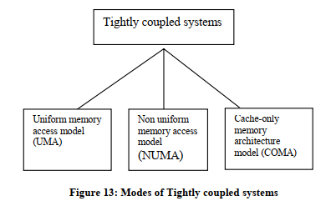
Cont..

Slide 32
UMA
Uniform Memory Access Model (UMA) In this model, main memory is uniformly shared by all processors in multiprocessor systems and each processor has equal access time to shared memory. This model is used for time-sharing applications in a multi user environment

Slide 33
NUMA
In shared memory multiprocessor systems, local memories can be connected with every processor.
The collection of all local memories form the global memory being shared. In this way, global memory is distributed to all the processors.
NUMA access to a local memory is uniform for its corresponding processor as it is attached to the local memory. But if one reference is to the local memory of some other remote processor, then the access is not uniform.
It depends on the location of the memory. Thus, all memory words are not accessed uniformly.

Slide 34
COMA
Shared memory multiprocessor systems may use cache memories with every processor for reducing the execution time of an instruction. Thus in NUMA model, if we use cache memories instead of local memories, then it becomes COMA model.
The collection of cache memories form a global memory space. The remote cache access is also non-uniform in this model

Slide 35
Loosely coupled system
These systems do not share the global memory because shared memory concept gives rise to the problem of memory conflicts, which in turn slows down the execution of instructions.
Each processor in loosely coupled systems is having a large local memory (LM), which is not shared by any other processor.
The systems have multiple processors with their own local memory and a set of I/O devices. This set of processor, memory and I/O devices makes a computer system so they called as multi-computer systems.
These computer systems are connected together via message passing interconnection network through which processes communicate by passing messages to one another.
These are also called loosely coupled systems, meaning that nodes have little coupling between them.

Slide 36
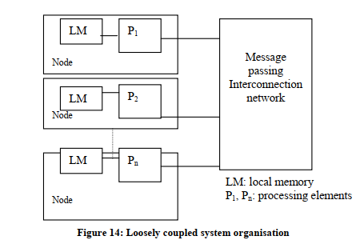
Loosely coupled system

Slide 37
Parallel Programming Model
a parallel computer (MIMD) can be characterised as a set of multiple processors and shared memory or memory modules communicating via an interconnection network.

Slide 38
Shared Memory Model
A shared memory system typically accomplishes inter-processor coordination through a global memory shared by all processors.
These are typically server systems that communicate through a bus and cache memory controller.
The bus/cache architecture alleviates the need for expensive multi-ported memories and interface circuitry as well as the need to adopt a message-passing paradigm when developing application software.
Each processor has equal opportunity to read/write to memory, including equal access speed.
SMP are well balanced & easy to implement.
Examples:
Sun Microsystems multiprocessor servers.
Silicon Graphics Inc. multiprocessor servers.

Slide 39
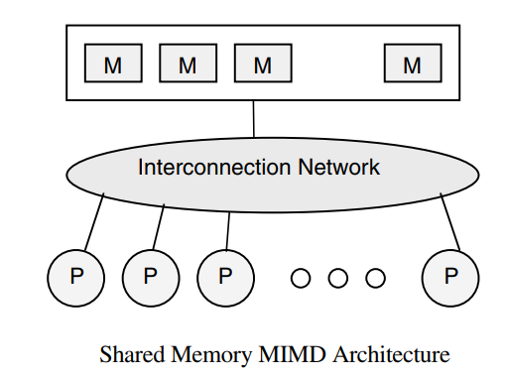
Shared Memory

Slide 40
Message Passing Model
A message passing system (also referred to as distributed memory) typically combines the local memory and processor at each node of the interconnection network.
There is no global memory, so it is necessary to move data from one local memory to another by means of message passing.
This is typically done by a Send/Receive pair of commands, which must be written into the application software by a programmer
Message passing model provide scalability to system.
Examples:
nCUBE, iPSC/2, and various Transputer-based systems

Slide 41
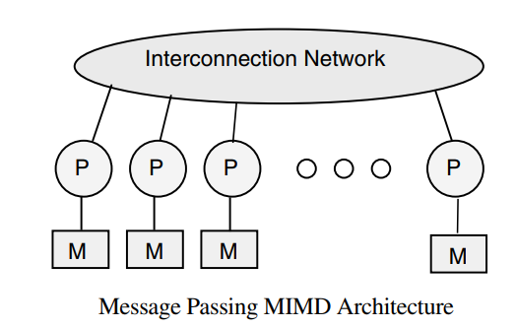
Message Passing Model

Slide 42
Performance Indicators: Amdahl’s Law
Gene Amdahl, chief architect of IBM's first mainframe series and founder of Amdahl Corporation and other companies found that there were some fairly stringent restrictions on how much of a speedup one could get for a given parallelized task. These observations were wrapped up in Amdahl's Law

Slide 43
Amdahl’s Law
Amdahl's Law is a statement of the maximum theoretical speed-up you can ever hope to achieve. The actual speed-ups are always less than the speed-up predicted by Amdahl's Law
If F is the fraction of a calculation that is sequential, and (1-F) is the fraction that can be parallelized, then the maximum speed-up that can be achieved by using P processors is 1/(F+(1-F)/P).

Slide 44
Example
If 90% of a calculation can be parallelized (i.e. 10% is sequential) then the maximum speed-up which can be achieved on 5 processors :
1/(0.1+(1-0.1)/5) = 3.6
(i.e. the program can theoretically run 3.6 times faster on five processors than on one)

Slide 45
If 90% of a calculation can be parallelized then the maximum speed-up on 10 processors is
1/(0.1+(1-0.1)/10) = 5.3
(i.e. investing twice as much hardware speeds the calculation up by about 50%).
If 90% of a calculation can be parallelized then the maximum speed-up on 20 processors is
1/(0.1+(1-0.1)/20) or 6.9
(i.e. doubling the hardware again speeds up the calculation by only 30%).

Slide 46
Essence: Amdahl’s Law
The point that Amdahl was trying to make was that using lots of parallel processors was not a viable way of achieving the sort of speed-ups that people were looking for. i.e. it was essentially an argument in support of investing effort in making single processor systems run faster.

